Slide 1
SIR Model for Pandemics
Group 4

Slide 2
Overview
Deterministic Model
Deterministic with
Demography
Stochastic with Demography

Slide 3
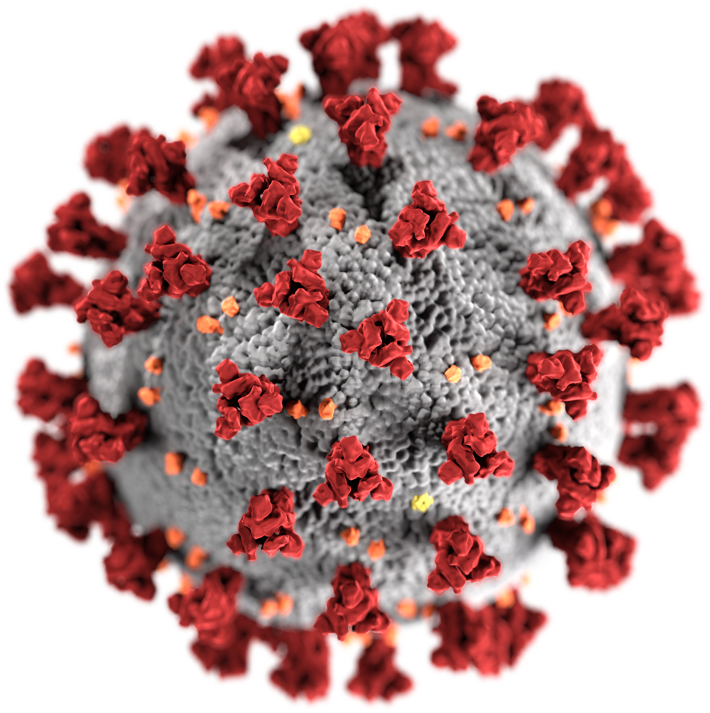
Importance of SIR Model
How many people are going to get infected?
How long will the pandemic stay with us?
What is the best way to reduce the impact of it?
What is the basic reproduction number of the disease?

Slide 4







Deterministic SIR Model
$$N=const→\frac{dS}{dt}+\frac{dI}{dt}+\frac{dR}{dt}=0$$
Susceptible
Infected
Recovered
$$\frac{dS}{dt}=−\frac{βIS}{N}$$
$$\frac{dI}{dt}=\frac{βIS}{N}−γ⋅I$$
$$S(t)$$
$$I(t)$$
$$R(t)$$
$β$ is the average number of people one person infects per day.
$γ=\frac{1}{D}$ where D is the average number of sickness days before recovery.

Slide 5
Assumptions
$\text{O}\text{nly} \text{one} \text{disease} \text{in} \text{the} \text{system}\text{.}$
Homogenous population - same probability to get infected.
$\text{Each} \text{ind}\text{i}\text{vidual} \text{can} \text{be} \text{infected} \text{once}\text{.}$
No latent period.

Slide 6



Basic Reproduction Number
$$R_{0}=\frac{\begin{aligned}number of people infected \\ by a person per day\end{aligned}}{recovery rate}=\frac{β}{γ}=β⋅D$$
$R_{0}≥1$ - Pandemic
$R_{0}<1$ - Endemic
How do we regulate it?

Slide 7
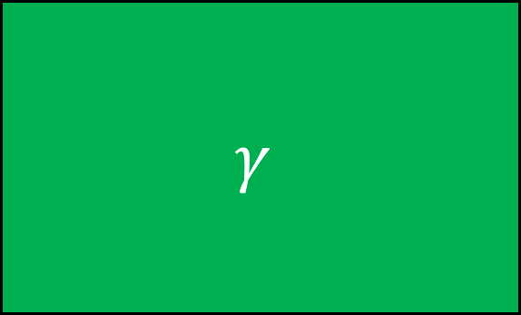

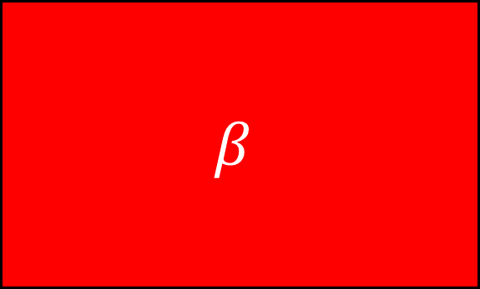
Does quarantine affect $β$ or $γ$?
$$γ$$
$$β$$

Slide 8
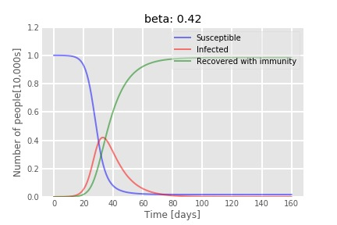
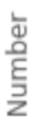
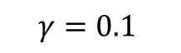
“Typical” Pandemic Graph
$$γ=0.1$$
Normalized population

Slide 9
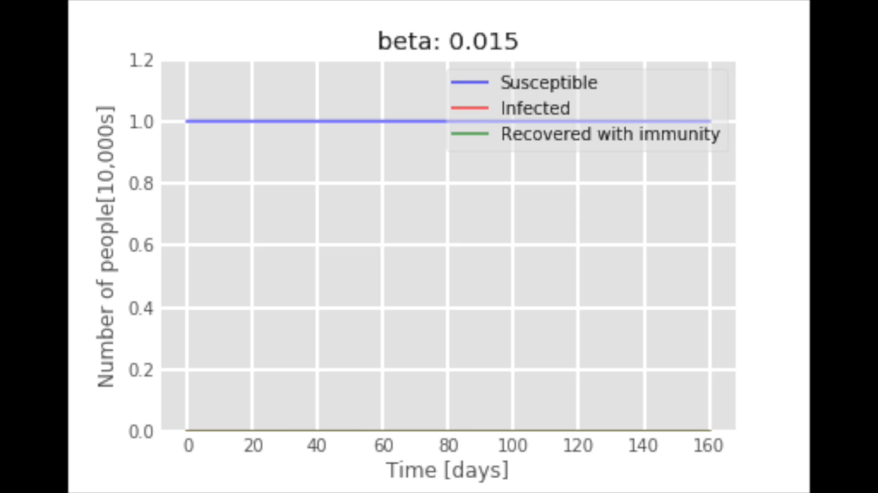
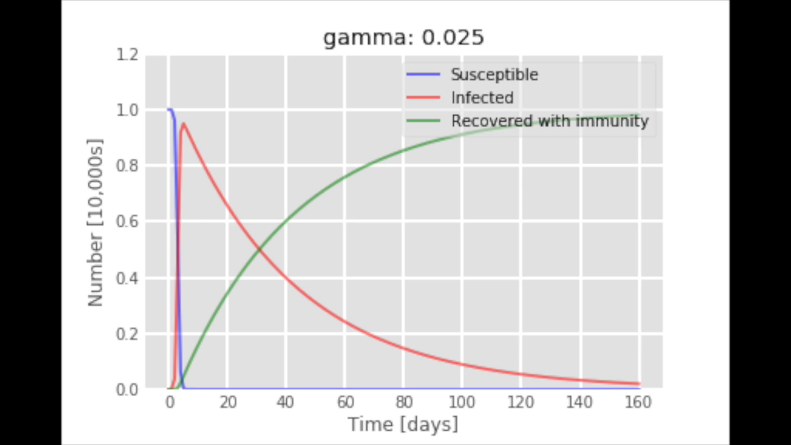

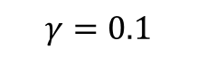
Changing the Parameters of the Disease
$$β=3$$
$$γ=0.1$$
Normalized population
Normalized population

Slide 10
What Else Can Affect the Model’s Prediction?
Demography
Culture
Hygiene
Vaccination
Progress of the country
Migration
Mutations
Restrictions
Quarantine

Slide 11




Deterministic SIR model with demography
$$μ_{birth}N$$
Susceptible
Infected
Recovered
$$\frac{dS}{dt}=−\frac{βIS}{N}$$
$$\frac{dI}{dt}=\frac{βIS}{N}−γ⋅I$$
$$S(t)$$
$$I(t)$$
$$R(t)$$
$$μ_{death}S$$
$$μ_{death}I$$
$$μ_{death}R$$
$$μ −Birth\backslash Death rate$$

Slide 12

Deterministic SIR Model with Demography
$$R_{0}=\frac{β}{γ} → R_{0}=\frac{β}{γ+μ}$$

Slide 13

$μ_{birth}=μ_{death}$ $→$ $N=const$
Will the model prediction change?
Yes
No

Slide 14
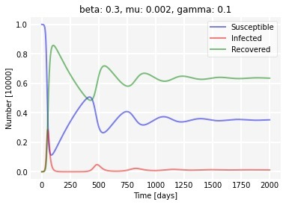
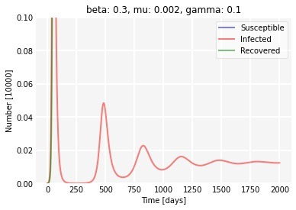

Deterministic SIR Model with Demography
Normalized population
Normalized population
Damped oscillations $→$ stationary state

Slide 15
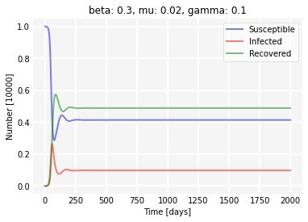
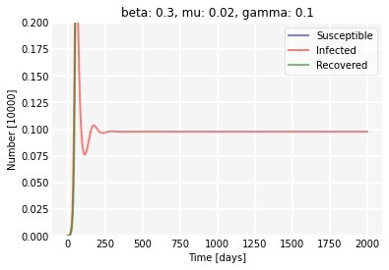
Birth Rate Effect
Normalized population
Normalized population

Slide 16
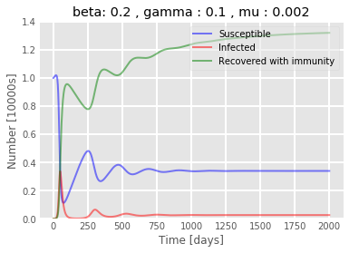


Birth Rate Effect
$$\frac{μ_{birth}}{μ_{death}}=1.7$$
Normalized population
$$N≠const$$

Slide 17
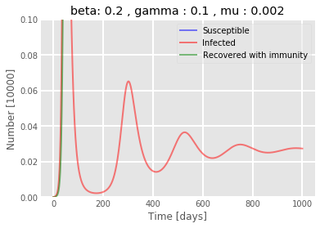
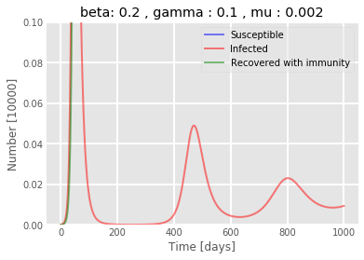



Birth Rate Effect
Ratio: 1.7
Ratio: 1
Normalized population
Normalized population
$$N≠const$$
$$N=const$$
Larger birth rate $→$ more infectives

Slide 18







Stochastic SIR Model with Demography
Markov process
$$μN+Δz_{2}$$
Susceptible
Infected
Recovered
$$\frac{dS}{dt}=−\frac{βIS}{N}+Δz_{1}$$
$$\frac{dI}{dt}=\frac{βIS}{N}−γ⋅I+Δz_{4}$$
$$S(t)$$
$$I(t)$$
$$R(t)$$
$$μS+Δz_{3}$$
$$μI+Δz_{5}$$
$$μR+Δz_{6}$$
$Δz_{i}$ - increments

Slide 19
Qualities of the Stochastic SIR
continuous Markov proc.
continuous time jump proc.
Continuousness
irreducible
reducible
Irreducibility
Einstein
Langevin
Approach

Slide 20
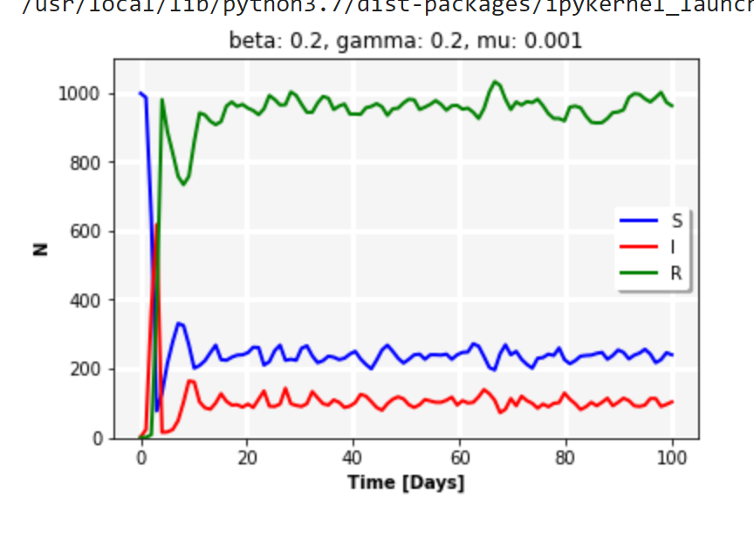
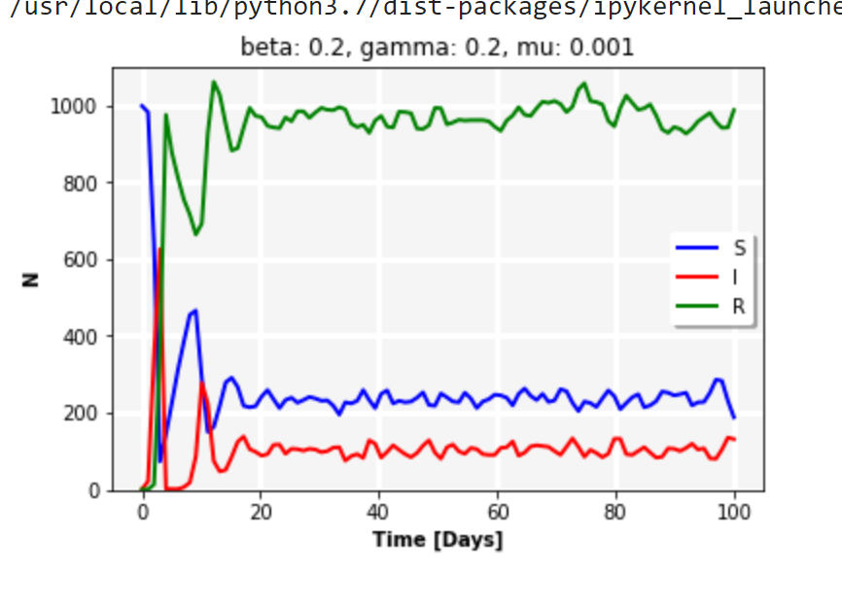
Randomness of the System
Different sample paths

Slide 21
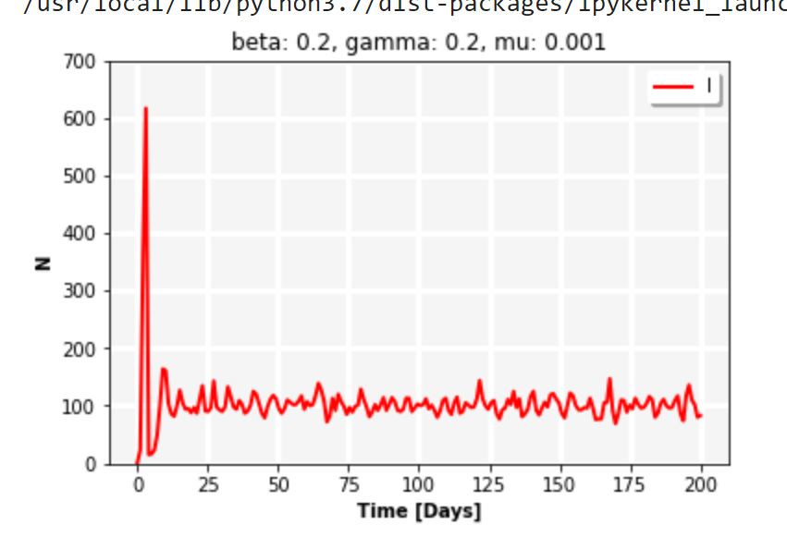
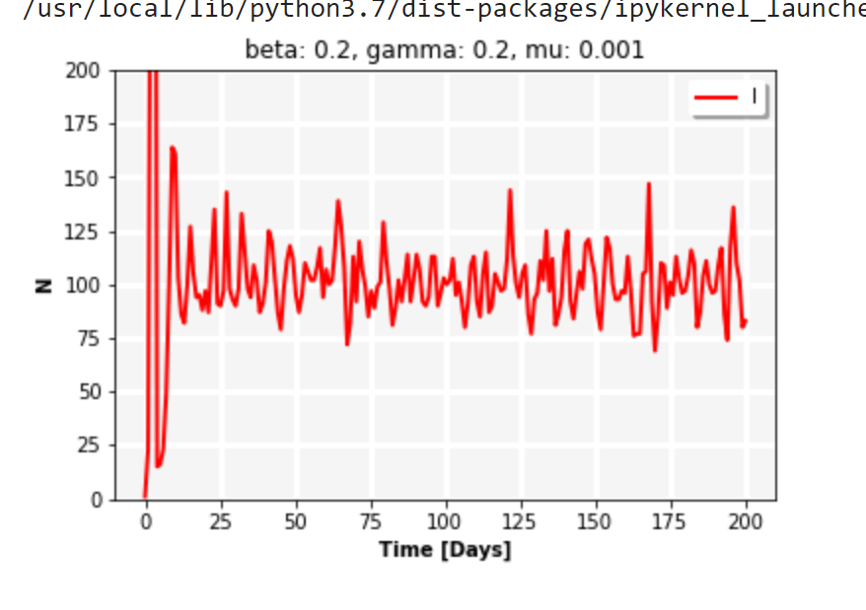
Stochastic Sustained Oscillations
Non-damped varying amplitude
Fluctuations around the deterministic equilibrium

Slide 22
What happens in the limit $N→∞$?

Slide 23
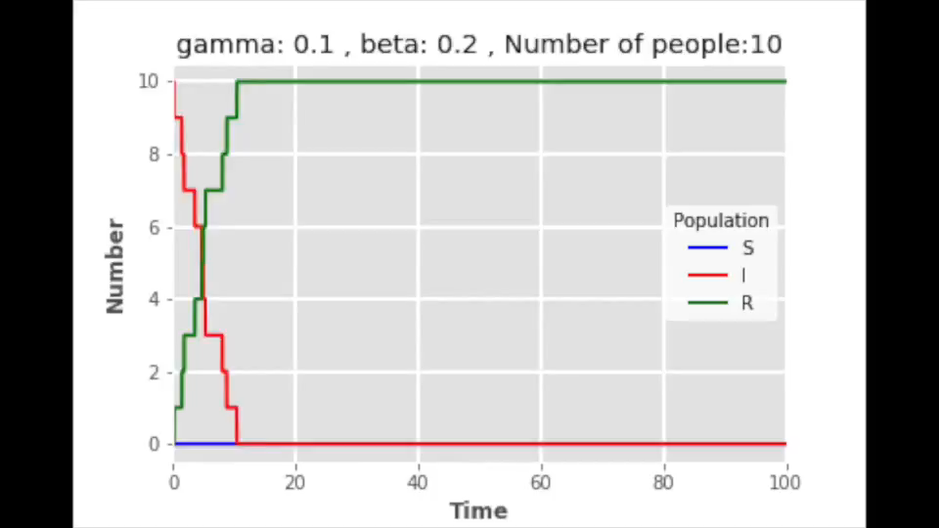

The Thermodynamic Limit

Slide 24
Summary
Deterministic model – simplified , less realistic , good for large sample groups.
$R_{0}$ can be reduced by changing $β$.
Even when considering just a few DOF we get interesting predictions.
When considering demography, the number of infected individuals stabilizes/oscillates around a nonzero value.
Amplitude of oscillations of the stochastic model – non damped.
$N→∞ ⇒$ Stochastic $→$ Deterministic.

Slide 25
References
Greenwood P.E., Gordillo L.F. (2009) Stochastic Epidemic Modeling. In: Chowell G., Hyman J.M., Bettencourt L.M.A., Castillo-Chavez C. (eds) Mathematical and Statistical Estimation Approaches in Epidemiology. Springer, Dordrecht.
Chunyan J., Daqing J. (2014) Threshold behaviour of a stochastic SIR model. In: Applied Mathematical Modelling.
Stochastic SIR model with Python. epirecipes: A cookbook of epidemiological models in R, Python, Julia and more. http://epirecip.es/epicookbook/chapters/sir-stochastic-discretestate-discretetime/python
The SIR epidemic model. Learning Scientific Programming with Python. https://scipython.com/book/chapter-8-scipy/additional-examples/the-sir-epidemic-model/

